Slide 1
1 - Introduction to Ethics
UECS3113
Computer Ethics and Professional Responsibility
Oct 2015
UECS3313-SE-Oct2015

Slide 2
Topics covered
Fundamentals of Ethics
Various ethical views
Ethics in society and business
Key ethical issues

Slide 3
Ethics – a definition
Ethics is the study of what it means “to do the right thing”
Usually the same meaning as morality

Slide 4
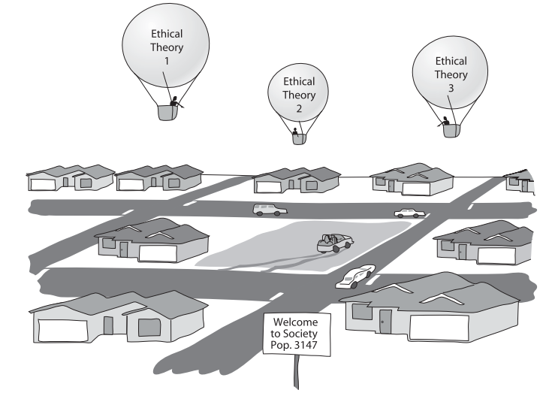
Ethics

Slide 5
New Developments
Blogs (Word made up from ‘web log’):
Began as outlets for amateurs who want to express ideas or creativity
Appealing because present personal views, are funny and creative, and present a quirky perspective on current events

Slide 6
New Developments (cont.)
Blogs (cont.):
Now used as alternatives to mainstream news and for business public relations
Popular blogs have 100,000 to 500,000 readers per day and can peak at several million views per day

Slide 7
New Developments (cont.)
Video Sharing:
Rise of amateur videos on the web
Boom of websites like Youtube and Myspace
Many videos on the web can infringe copyrights owned by entertainment companies

Slide 8
New Developments (cont.)
Cell Phones:
Can now be used for travel, last minute planning, taking pictures and downloading music
Talking on cell phones while driving is a problem
Cell phones can interfere with solitude, quiet and concentration
Cameras in cell phones and privacy issues
Notes:
Some states have passed laws prohibiting use of hand-held devices. Recent studies show hands-free devices, while freeing up the hands, do not reduce distractions, particularly among young adult and teenage drivers who often text message while driving.
Cameras in cell phones threaten privacy. Where is the line between capturing news events and evidence of crimes, and voyeurism?

Slide 9
New Developments (cont.)
Social Networking:
First online social networking site was www.classmates.com in 1995
Myspace, founded in 2003 had roughly 100 million member profiles by 2006
Facebook was started at Harvard as an online version of student directories
Notes:
Sites like Second Life (www.secondlife.com) combine many of the features of social networking sites with the 3-D aspects of video games. What new problems/benefits arise when a person can take on a physical persona (an avatar) that may be completely different from who they are in real life? Some people with physical disabilities can interact with others without revealing their handicap.

Slide 10
New Developments (cont.)
Collaboration:
Wikipedia, the online, collaborative encyclopedia
Open Directory Project (ODP)
Collaboration between scientists in different states or countries
Watch-dogs on the Web
Notes:
Wikipedia’s reliability was brought into question when a major contributor was found to be a 14 year-old boy instead of a scientist with a PhD and years of experience. He got most of his information from other Web sources.
Web Watch-dog sites are controversial. A web site where a woman can publish the names and pictures of men who other women should watch out for has made the news recently.

Slide 11
New Developments (cont.)
E-commerce and Free Stuff:
Free stuff on the web: email, books, newspapers, games, etc.
www.Amazon.com started in 1994 and 10 years later annual sales reached $8.5 billion
TV show episodes are available to view on the Web

Slide 12
New Developments (cont.)
Artificial Intelligence (AI), Robotics, and Motion:
AI suited to narrow, specialized skills
Robotic devices often special-purpose devices, and may require AI to function
Motion sensing devices are used to give robots the ability to walk, trigger airbags in a crash and cushion laptops when dropped

Slide 13
New Developments (cont.)
Tools for Disabled People:
Restoration of abilities, productivity and independence
Screen readers and scanners
Speech recognition
Prosthetics and motion sensors

Slide 14
New Developments (cont.)
What’s Next?
Medical records on chips attached to medical bracelets
Biological and computer sciences will combine new ways to insert micro-processors or controlled devices on human bodies

Slide 15
Issues and Themes
Issues:
Unemployment
Alienation and customer service
Crime
Loss of privacy
Errors

Slide 16
Issues and Themes (cont.)
Themes:
Old problems in a new context: crime, pornography, violent fiction
Adapting to new technology: thinking in a new way
Varied sources of solutions to problems: natural part of change and life

Slide 17
Issues and Themes (cont.)
Themes (cont.):
Global reach of net: ease of communication with distant countries
Trade-offs and controversy: increasing security means reducing convenience
Difference between personal choices, business policies, and law

Slide 18
Ethics
Ethical Views:
Divine Command Theory
Deontological
Utilitarianism
Social Contract Theory
No simple answers
  Do organizations (businesses) have ethics?

Slide 19
Divine command theory
The ethical value of an action somehow depends on God.
The ethically correct action is the one commanded by God
(example: Ten Commandments)

Slide 20
Divine command theory
We owe obedience to our Creator
God is all-good and all-knowing.
God is the ultimate authority.

Slide 21






Simple answer (right ?!)
Being ethical simply means following:
Bible / being a good Christian
Quran or Sunnah / being a good Muslim
Eight-fold path / being a good Buddhist
Bhagavad Gita / being a good Hindu
Dao De Jing / being a good Taoist
Guru Granth Sahib / being a good Sikh

Slide 22
Similarity of religious ethics
Agreement on many things that are ethically wrong
  Stealing, lying, killing, greediness, etc
Agreement on many things that are ethically right
  Honesty, generosity, kindness, forgiveness, hardworking, etc

Slide 23
Diversity of religious ethics
There are many holy books, and some of their teachings disagree with each other.
It is unrealistic to assume a multicultural society will adopt a religion-based morality
Some moral problems are not addressed directly in scripture.
It is fallacious to equate “the good” with “God.”
The divine command theory is based on obedience, not reason.

Slide 24
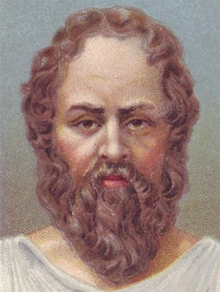
Euthyphro dilemma (Plato’s Dialogue)
Is an action moral because God commands it
OR
does God command an action because it is moral ?

Slide 25

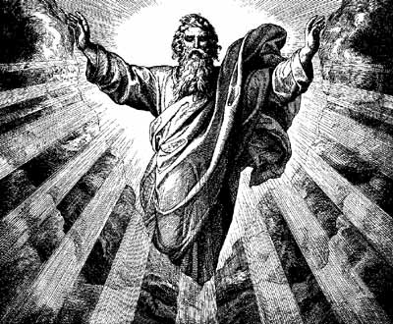

Euthyphro dilemma
If an action is moral because God commands it
  God’s commands are arbitrary, and so is morality
  God is no different from a powerful despot !

Slide 26
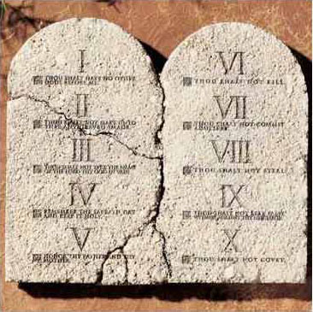
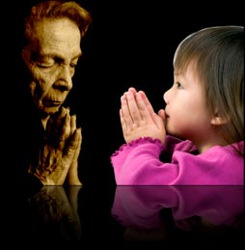
Euthyphro dilemma
If God commands an action because it is moral
  True morality or ethics exists separately and independently from God

Slide 27
Diversity of religious ethics
What kind of diet is permissible ?
Pork and alcohol is not allowed
Beef is not allowed
Any kind of meat is not allowed
Anything that I can eat is allowed

Slide 28
Diversity of religious ethics
How many wives are permissible ?
Only one
Up to four
As many as you can afford ☺

Slide 29
Diversity of religious ethics
Christianity
  Catholic, Orthodox, Protestant (Lutherans, Baptist, Anglican, Methodist, Evangelicals, etc)
Islam
  Sunni (Hanafi, Hanbali, Maliki and Shafi'i), Shia, Sufis, Ahmadiyya
Buddhism
  Theravada, Mahayana, Vajrayana
Hinduism
  Caste system – Brahmin, Kshatruyas, Vaisyas, Shudras

Slide 30
Religion and ethics
Religions are systems of belief and practice that try to express some kind of human relationship to a higher power (God)
Religion is NOT GOD !

Slide 31
Some points
There are flaws in divine command theory
  However, we can still (and even should) turn to religion as a source of ethics
Non-religious ethical theories are useful
  Allow us to discuss and debate without answering the BIG question

Slide 32
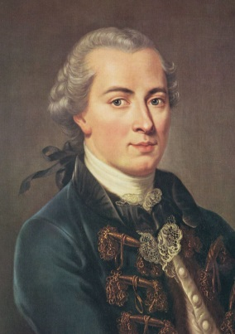
Deontological theories -Kantianism
Duty and absolute rules
  that people’s actions ought to be guided by moral laws, and that these moral laws were universal.
  Followed regardless of consequences
  Use of logic and reason to determine rules
  Treat people as ends, not as a means to an ends

Slide 33
Deontological theories -Kantianism
“Ought to” called dutifulness.
Two formulation:
  Act only from moral rules that you can at the same time will to be universal moral laws.
    “A person may make a false promise when that is the only way to escape a difficult situation.”
  Act so that you always treat both yourself and other people as ends in themselves, and never only as a means to an end.
    It is wrong for one person to use himself or another person solely as a means to an end.

Slide 34
Deontological theories -Kantianism
Advantages
  Kantianism is rational.
  Kantianism produces universal moral guidelines.
  All persons are treated as moral equals.

Slide 35
Deontological theories -Kantianism
Disadvantages
  Sometimes no single rule fully characterizes an action..
  Sometimes there is no way to resolve a conﬂict between rules.
  Kantianism allows no exceptions to perfect duties.
  .

Slide 36
Utilitarianism
an action is good if it beneﬁts someone; an action is bad if it harms someone.
An action is right (or wrong) to the extent that it increases (or decreases) the total happiness of the affected parties.
If the sum is positive, the action is good. If the sum is negative, the action is bad.

Slide 37
Utilitarianism
A state is considering replacing a curvy stretch of highway that passes along the out skirts of a large city. Would building the highway be a good action?

Slide 38
Act Utilitarianism: Advantage
It focuses on happiness.
It is down-to-earth.
It is comprehensive.

Slide 39
Act Utilitarianism: Problems
Difficult to determine all the consequences.
Difficult to understand the values and needs of everyone affected.
Difficult to quantify happiness.
Difficult to decide whose utility should be considered more significant.
Does not recognize or respect individual rights.

Slide 40
Rule utilitarianism
Applies utility principle not to individual actions but to general ethical rules.
There is no utility calculation for each unique instance
Rules are generally stated in terms of rights to life and property (natural rights)

Slide 41
Rule utilitarianism - Advantage
Not every moral decision requires performing the utilitarian calculus.
Exceptional situations do not over throw moral rules.
Rule utilitarianism solves the problem of moral luck.
Rule utilitarianism avoids the problem of egocentrism.
It appeals to a wide cross section of society.

Slide 42
Rule utilitarianism - Disadvantage
Utilitarianism forces us to use a single scale or measure to evaluate completely different kinds of consequences.
Utilitarianism ignores the problem of an unjust distribution of good consequences.

Slide 43
Social Contract theory
“simply the rules that are necessary if we are to gain the beneﬁts of social living”.
Rational people understand that cooperation is essential.
Social Contract
  the establishment of such a set of moral rules to govern relations among citizens,
  a government capable of enforcing these rules.

Slide 44
Social Contract theory
“Morality consists in the set of rules, governing how people are to treat one another, that rational people will agree to accept, for their mutual beneﬁt, on the condition that others follow those rules as well”.

Slide 45
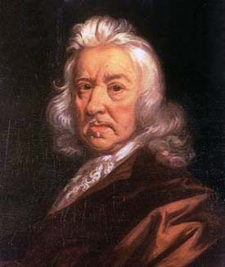
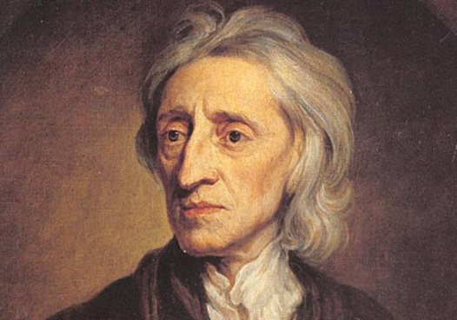
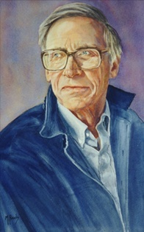
Social Contract theory
Give up some of their independence
  common law and some authority (government) to enforce
Need for public endorsement of constitution
  Must protect basic liberties
  Allow people to make effective use
  Utility of the least advantaged people

Slide 46
Social contract (Malaysia)
agreement in the Constitution.
trade-off: in return for citizenship to the non-Bumiputera, the Malays obtain special rights and privileges.

Slide 47
Social Contract theory -Natural rights
Support autonomy to increase happiness
  act freely according to their own judgment
Ethical behaviour acting in a way that respects a set of fundamental rights of others
  for e.g. rights to life, liberty, and property
Nature of humanity

Slide 48
Social Contract theory- Natural rights
Negative rights
  Right that another can guarantee by leaving you alone to exercise your right. (Ex: the right of free expression is a negative right)
Positive rights
  Right that obligates others to do something on your behalf. (Ex: free education provided by the society).
Absolute right
  is a right that is guaranteed without exception.
Limited right
  may be restricted based on the circumstances

Slide 49
Social Contract theory -Negative and positive rights
Negative rights
  rights to act without interference
  to life and to be free from assault
  to own and use property
  to use labor to create goods and services
  to have a religion of choice
  to freely express one self through speech
Positive rights
  obligation on some people to provide certain things for others

Slide 50
Social Contract theory - Advantage
It is framed in the language of rights.
It explains why rational people act out of self-interest in the absence of a common agreement.
It provides a clear ethical analysis of some important moral issues regarding the relationship between people and government.

Slide 51
Social Contract theory - Disadvantage
None of us signed the social contract.
Some actions can be characterized in multiple ways.
Social contract theory does not explain how to solve a moral problem when the analysis reveals conﬂicting rights.
Social contract theory may be unjust to those people who are incapable of upholding their side of the contract.

Slide 52
Golden rule
Do not do towards others what you do not want them to do towards you
Do towards other what you want others to do towards you

Slide 53
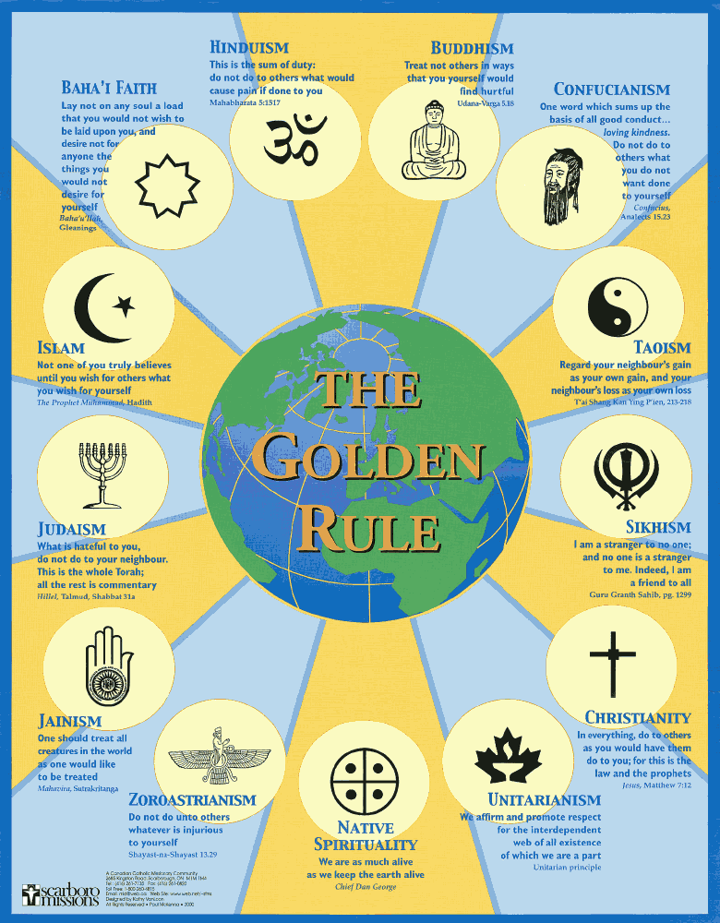

Slide 54
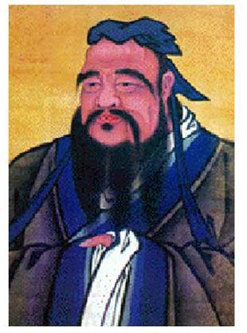
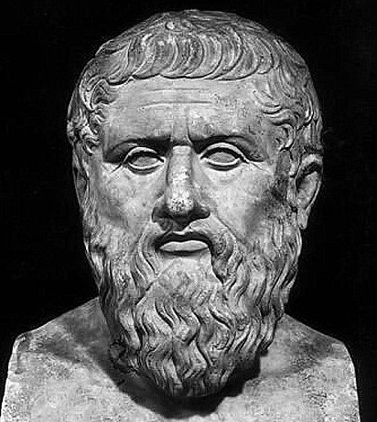
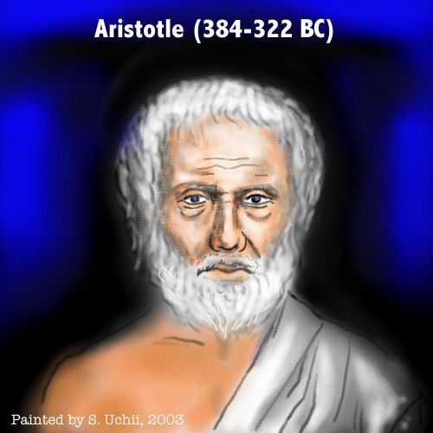
Virtuous Life
Focus on living a virtuous life.
  The most important thing is building a good / moral character
  virtuous acts flows naturally from a virtuous character

Slide 55
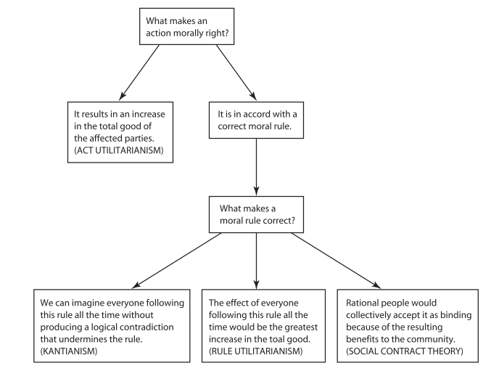
Basis of ethical theories

Slide 56
Basis of ethical theories
People are rational and make free choices
Goals are to achieve peace, happiness, well being, human dignity
  People are unique: values and goals
Two views:
  Fundamental and universal
  Rules that are made up
Ethical behaviour has practical benefits:

Slide 57
Ethics in business
Businesses and organizations are legal entities
  Management shapes the culture or ethics of a business or organization: by providing examples
A distinction can be made between valid goals and actions used to accomplish these goals

Slide 58
Key issues
No simple answers
Ethically obligatory, prohibited and acceptable
Distinguishing wrong and harm
Personal preference and ethics
Law and ethics
  Ethics helps us to determine the law

